Slide 1

Federation of European Women Pilots founded September 23rd 1995 in Rome www.FEWP.info
Date, place and reason for the presentation
Logo of the organisation that invited you

Slide 2

Aviation background Nathalie Chudiak
1971-2000: skydiving, 1000+ jumps
on all continents except Africa.
1988-present: flying PPL, 800+ hours
including 100 aerobatic, 240 helicopter.
2006-present: MVCB (Cessna 172, Eurofox)
2013-present: VCS (Katana DV20, Robin DR400).
Member of VVMV, KNVvL, AOPA NL, IFFR Benelux
2004-present: FEWP, member of the board,
secretary and president since 2017.
YOUR OWN AVAITION BACKGROUND

Slide 3

Aims of the Federation
To cultivate and retain links
between women pilots.
To provide opportunities for women pilots
to meet and fly to all European countries.
To develop international relationships between women pilots.
To promote aviation to women
and support women in aviation.

Slide 4

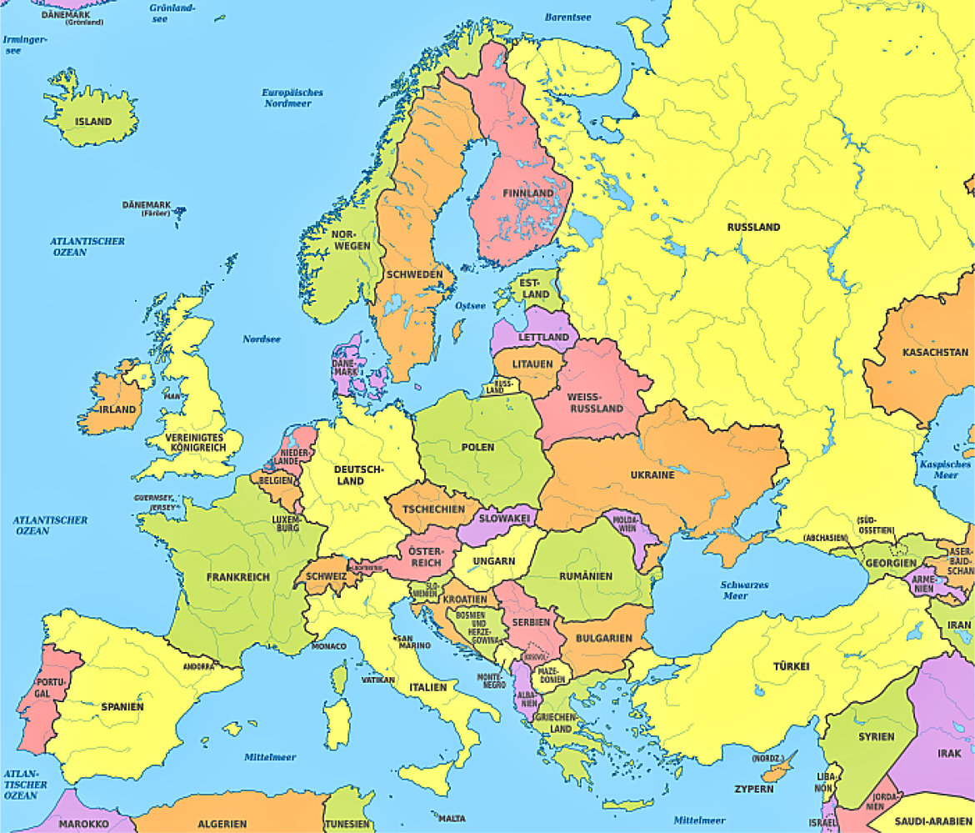












Countries member of FEWP

Slide 5
National Organisations represented in FEWP
Austria: Verein der österreichischen Pilotinnen
Cyprus: Association of Cyprus Women Pilots
France: Association Française des Femmes Pilotes
Germany: Vereinigung Deutscher Pilotinnen
Italy: Associazione Donne dell’Aria
Netherlands: Stichting Nederlandse Vrouwen in de Luchtvaart
Serbia: Womens Aeronautical Association of Serbia
Slovenia: Drustvo Slovenskih Letalk
Switzerland: Association Suisse des Femmes Pilotes
United Kingdom: British Women Pilots Association

Slide 6
Dates of founding and numbers of membership
Austria: VöP 1985 47
Cyprus: ACWP 2020 ?
France: AFF 1971 200
Germany: VDP 1968 300
Italy: ADA 1979 140
Netherlands: SNVL 2019 26
Serbia: WAAS ? ?
Slovenia: DSL 1989 27
Switzerland: ASFP 2008 86
United Kingdom: BWPA 1955 300

Slide 7
Countries represented in FEWP
on individual basis
Belgium: Nathalie Chudiak
Romania: Eleonora Lunga
Spain: Teresa Quamada Vives
All countries are in the process
of establishing a national organisation.

Slide 8
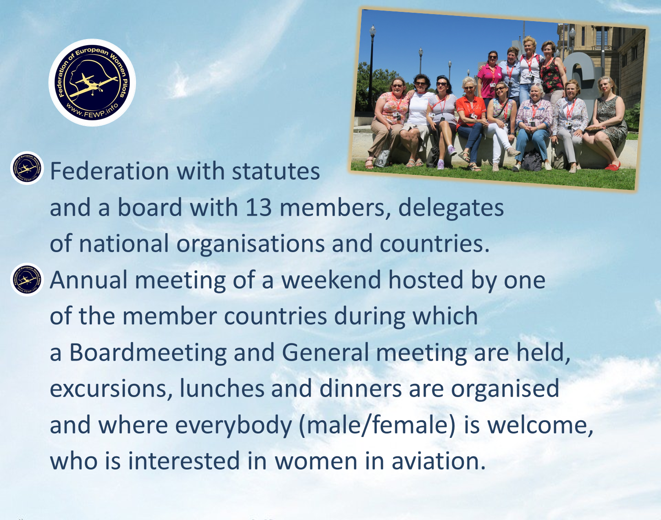

Slide 9

Subjects discussed during the Board- and Annual General Meeting
Minutes of the previous meeting
Presidents report
Country reports by delegates
Financial situation
Website
Election of board members
Future meetings

Slide 10
Annual Meetings FEWP
1995 Rome, Italy
1996 Dresden, Germany
1997 Eindhoven, Netherlands
1998 Munich, Germany
1999 Luxembourg
2000 Stratford-on-Avon, England
2001 Florence, Italy
2002 Baune, France
2003 Lausanne, Switzerland
2004 Salzburg, Austria
2005 Bled, Slovenia
2006 Cambridge, England
2007 Chiemsee, Germany
2008 Trento, Italy
2009 Dijon, France
2010 Bex, Switzerland
2011 Rome, Italy
2012 Wachau, Austria
2013 Lutjomer, Slovenia
2014 Chiemsee, Germany
2015 Brasschaat, Belgium
2016 Caposile, Italy
2017 Paris, France
2018 Wyboston, England
2019 Barcelona, Spain
2020 Corona Covid-19
2021 Cyprus
2022 Romania
2023 Serbia
2024 Slovenia

Slide 11

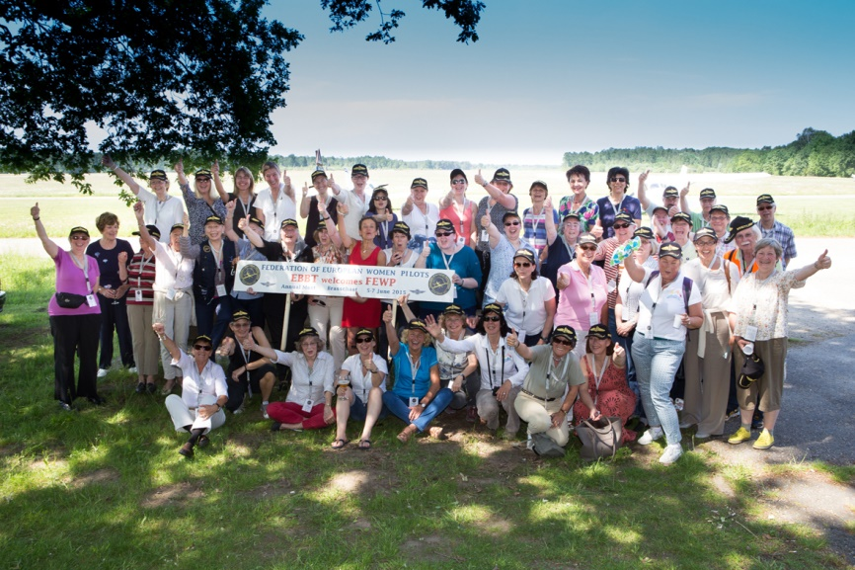
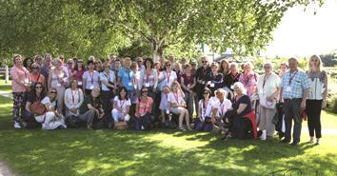
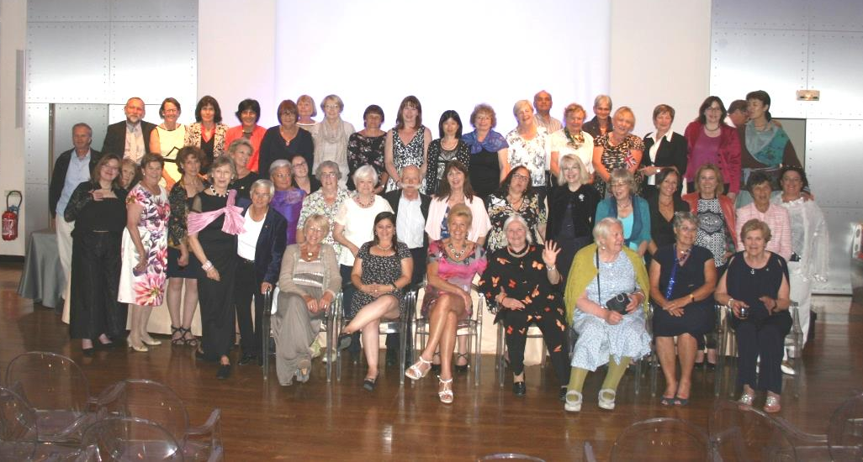
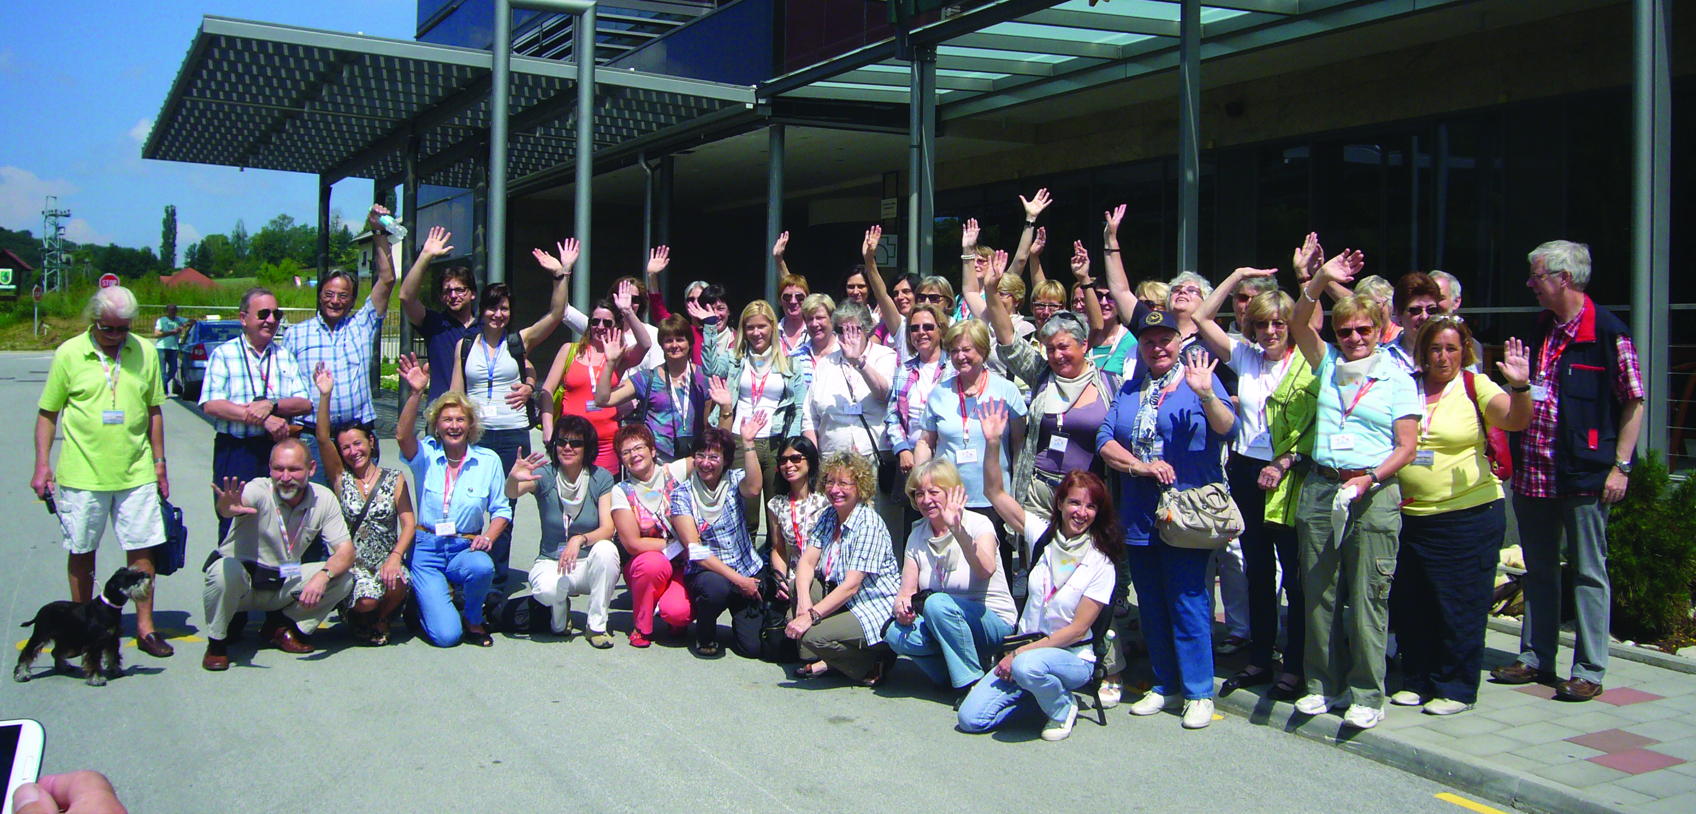
Annual weekends
2018 Wyboston, UK
2015 Brasschaat, Belgium
2013 Ljutomer, Slovenia
2017, Paris, France

Slide 12

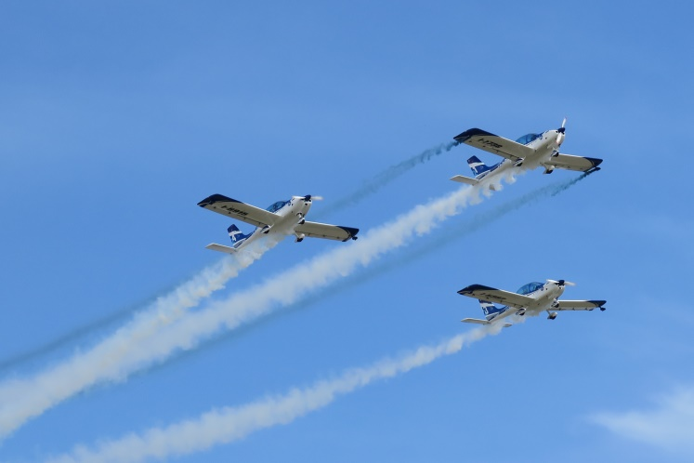
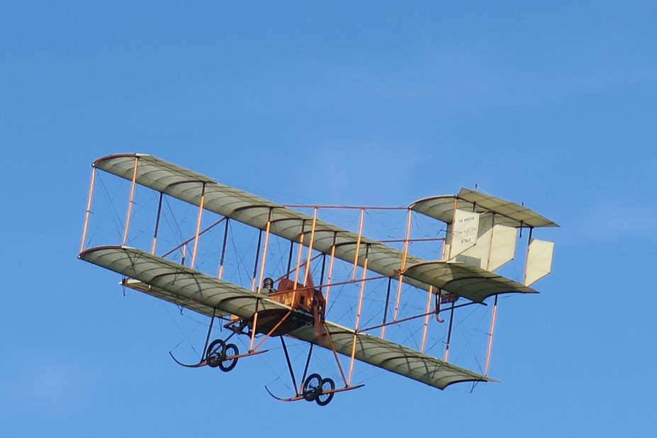
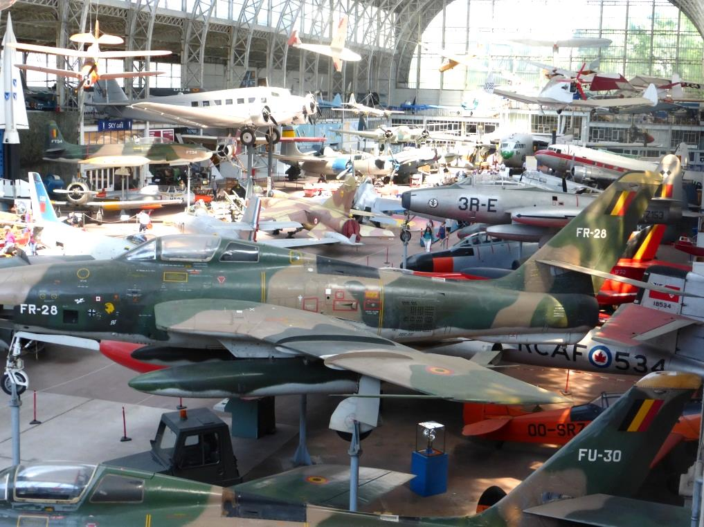
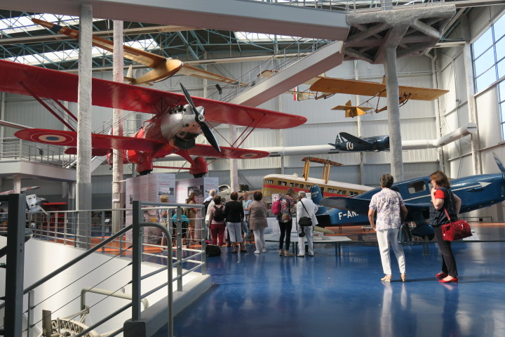
Excursions
Demonstration of WeFly, 2016 Italy
Edwardian planes, 2018 Old Warden
Aviation Museum, 2017 France
Army Museum, 2015 Belgium

Slide 13
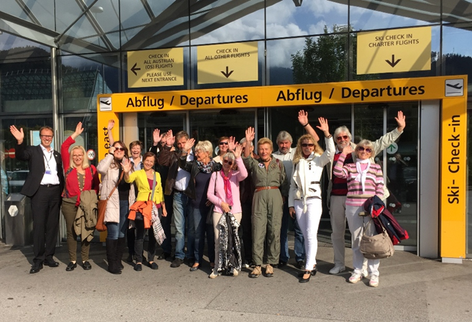

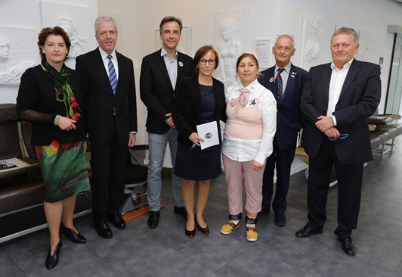
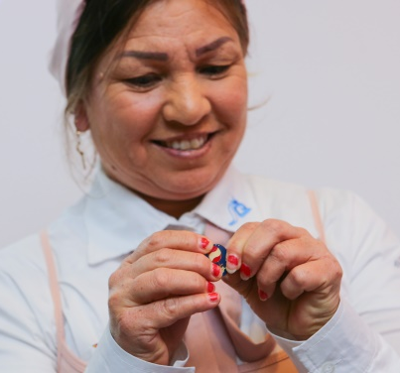
Verein österreichischen Pilotinnen
The association was founded in 1985 and has 47 active members.
First aim: To inspire young women to fly: organising Fly Ins at all Austrian airfields.
Second aim: To connect women pilots and encourage them to visit each other and fly together.
Third aim: Help and encourage other women pilots and eliminate obstacles
on their way to aviation.
On International Woman’s Day 2019 Colonel Latifa Nabizada, MSc. was welcomed. She is the first female helicopterpilot in Afghanistan. She was endangered in her home country and now lives in Austria. She was greeted by many officials and is now
a honorary member of VöP.

Slide 14

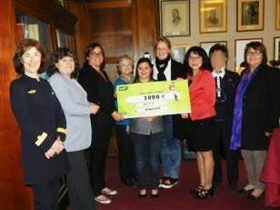
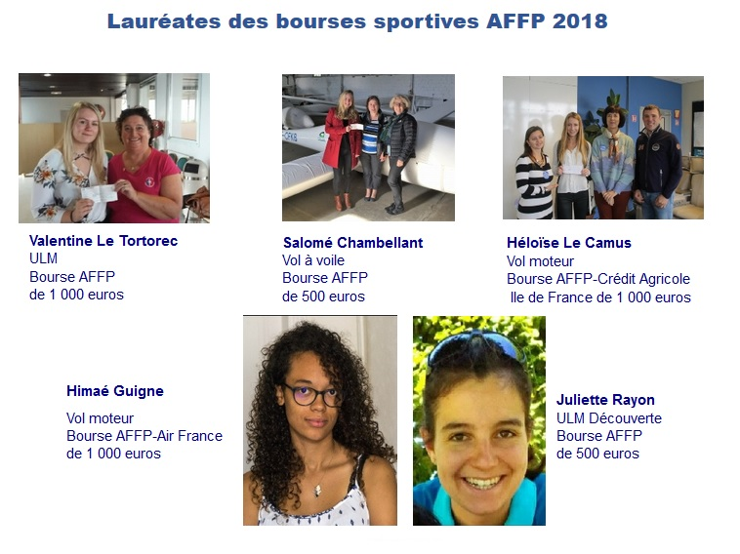

Association Française des Femmes Pilotes
The French Association of Women Pilots was founded in 1971 and has more than 200 members. Main goals are personal and financial assistance to women in aviation and the promotion of communication between women
in airsports and professional aviation positions.

Slide 15
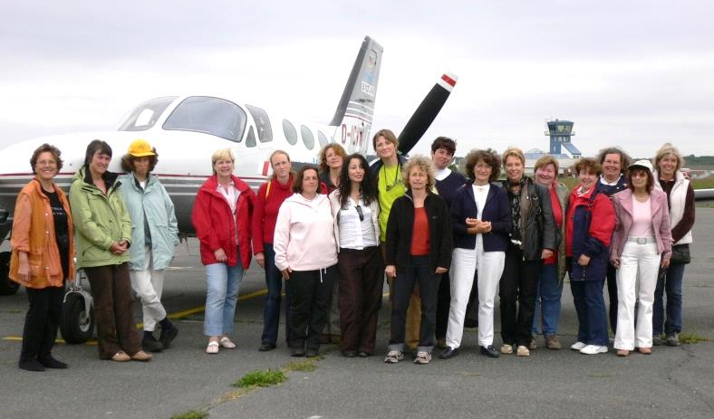
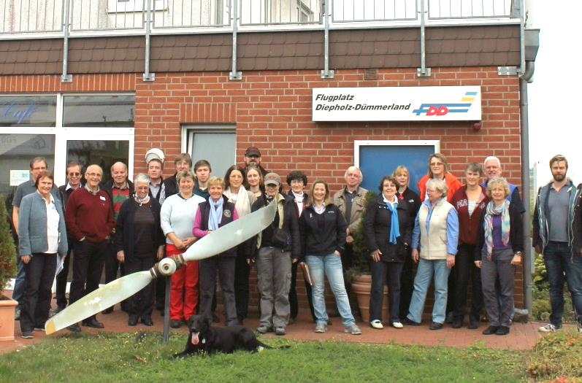
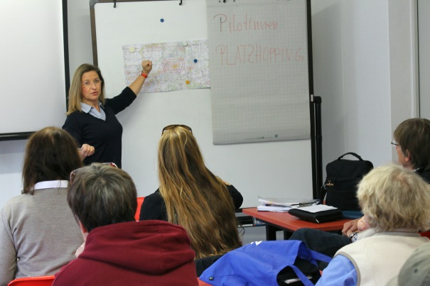
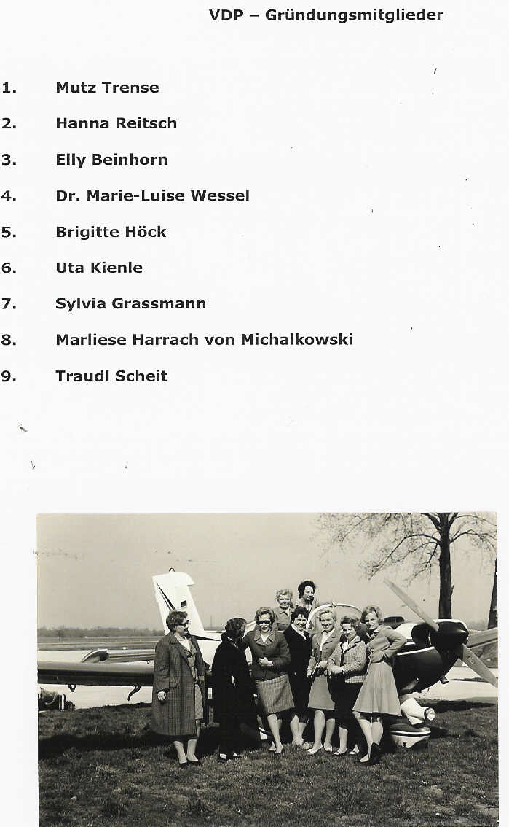


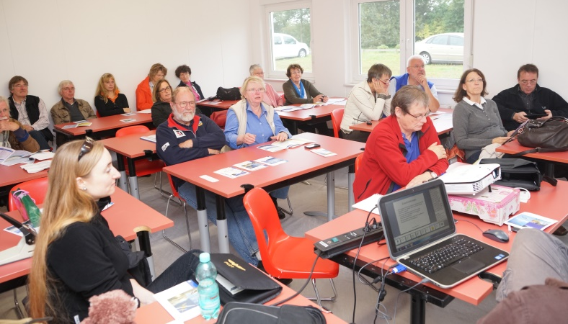


Vereinigung Deutscher Pilotinnen
VDP is founded in April 1968 and has around 300 members.
Focal points are: networking, support women in their flying skills and safety, remember the flying women pioneers.

Slide 16
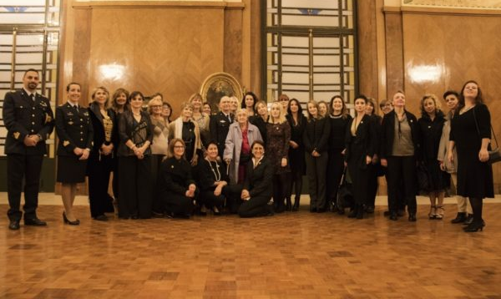

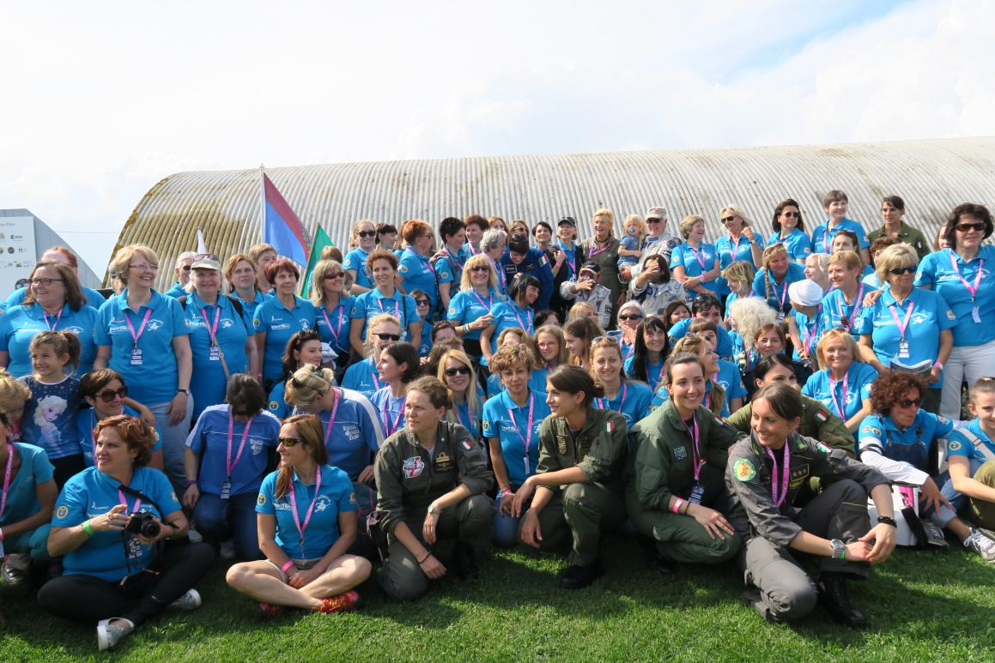
Associazione Donne dell’Aria
ADA was founded in 1979 by Fiorenza di Bernardi as Italian Women Pilot Asso-ciation. The name was changed later. ADA has 140 members. Fiorenza is still president of ADA.
First ADA meeting in Rome 2019
Three focal points of ADA:
To create a aeronautical female network.
To help women to find their position in the aeronautical world.
To support projects and activities to promote women in the aeronautical world.
Fly Donna Meet 2016 Caposile

Slide 17
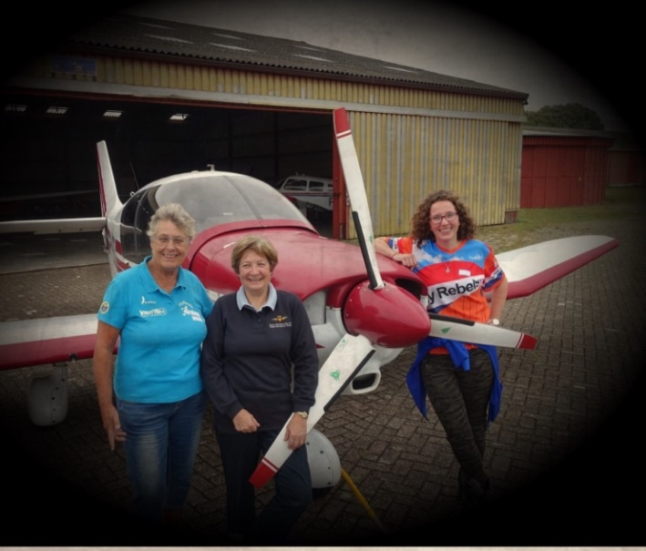
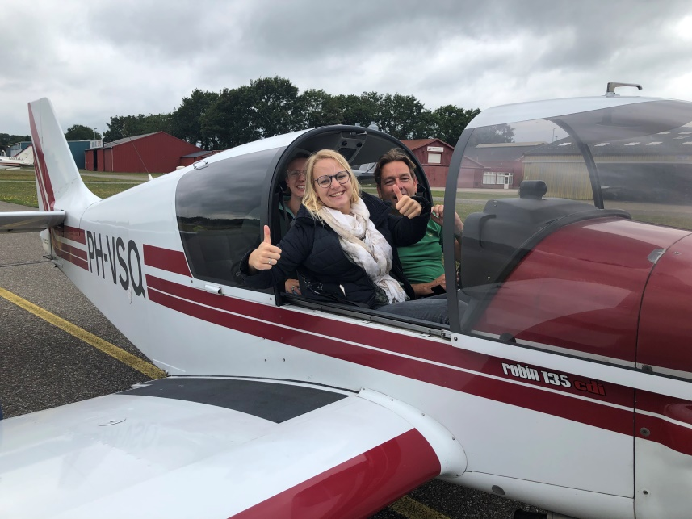
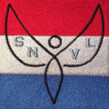
Stichting Nederlandse Vrouwen in de Luchtvaart
The Foundation of Dutch Women in Aviation was founded January 25th 2019. At the moment SNVL has 26 members .
The opening weekend in August 2019 with a Fly In on the airfield of Seppe was very successful with demonstrations of airsports, presentations and excursions.
The maingoal is to lower the threshold which seems to hold back women in getting in any aspects of aviation activities.
To organise aeronautical sport activities and meetings and to give opportunity to experience airsports.

Slide 18

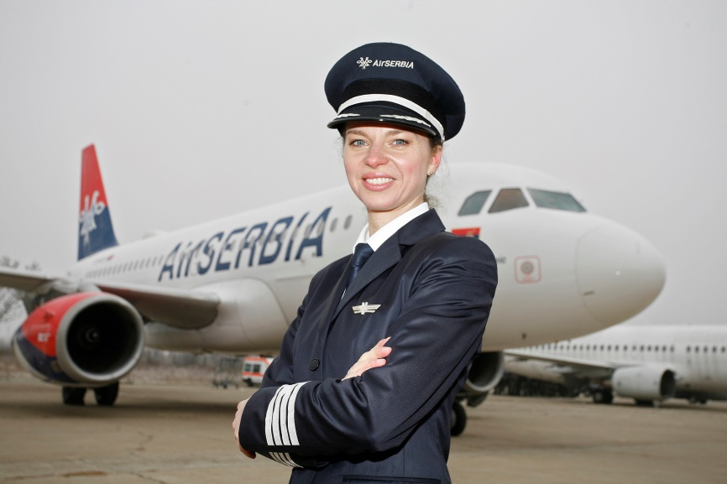
Women’s Aeronautical Association of Serbia
No information from Serbia received about year of founding or numbers of members. Picture and text from website WAAS.
Vesna Aleksić always dreamed
of flying for the national airline,
and by joining Air Serbia she has not only achieved that goal but became the first female captain in the flag carrier’s history.

Slide 19
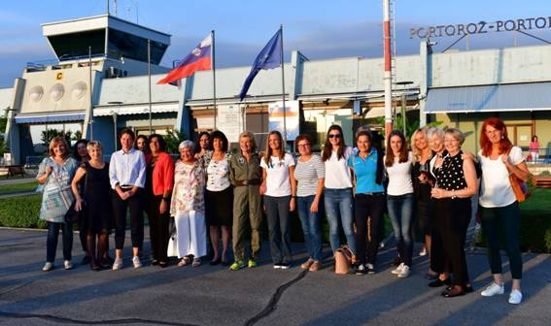

Drustvo Slovenskih Letalk
The Slovenian Women Pilot Association was founded in 1989 and has 27 members.
The most important activity is showing the love for flying among women
and encourage them to fly.
DSL organises aviation events to share experiences and expectations.

Slide 20
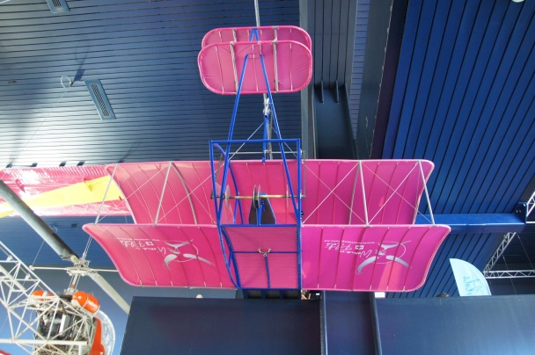

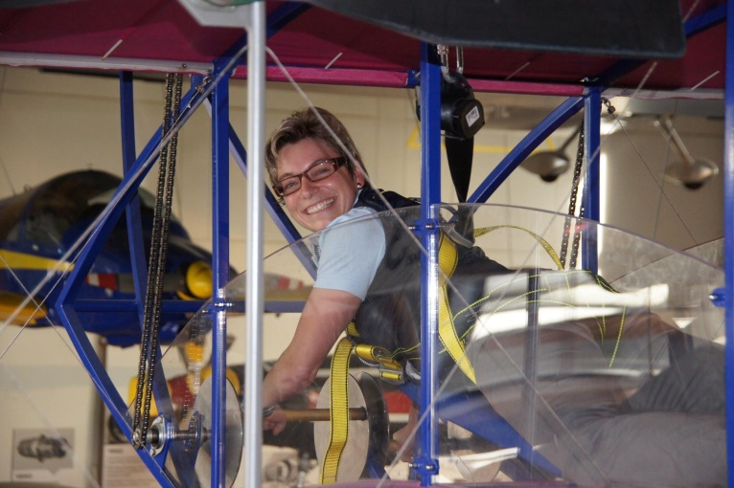
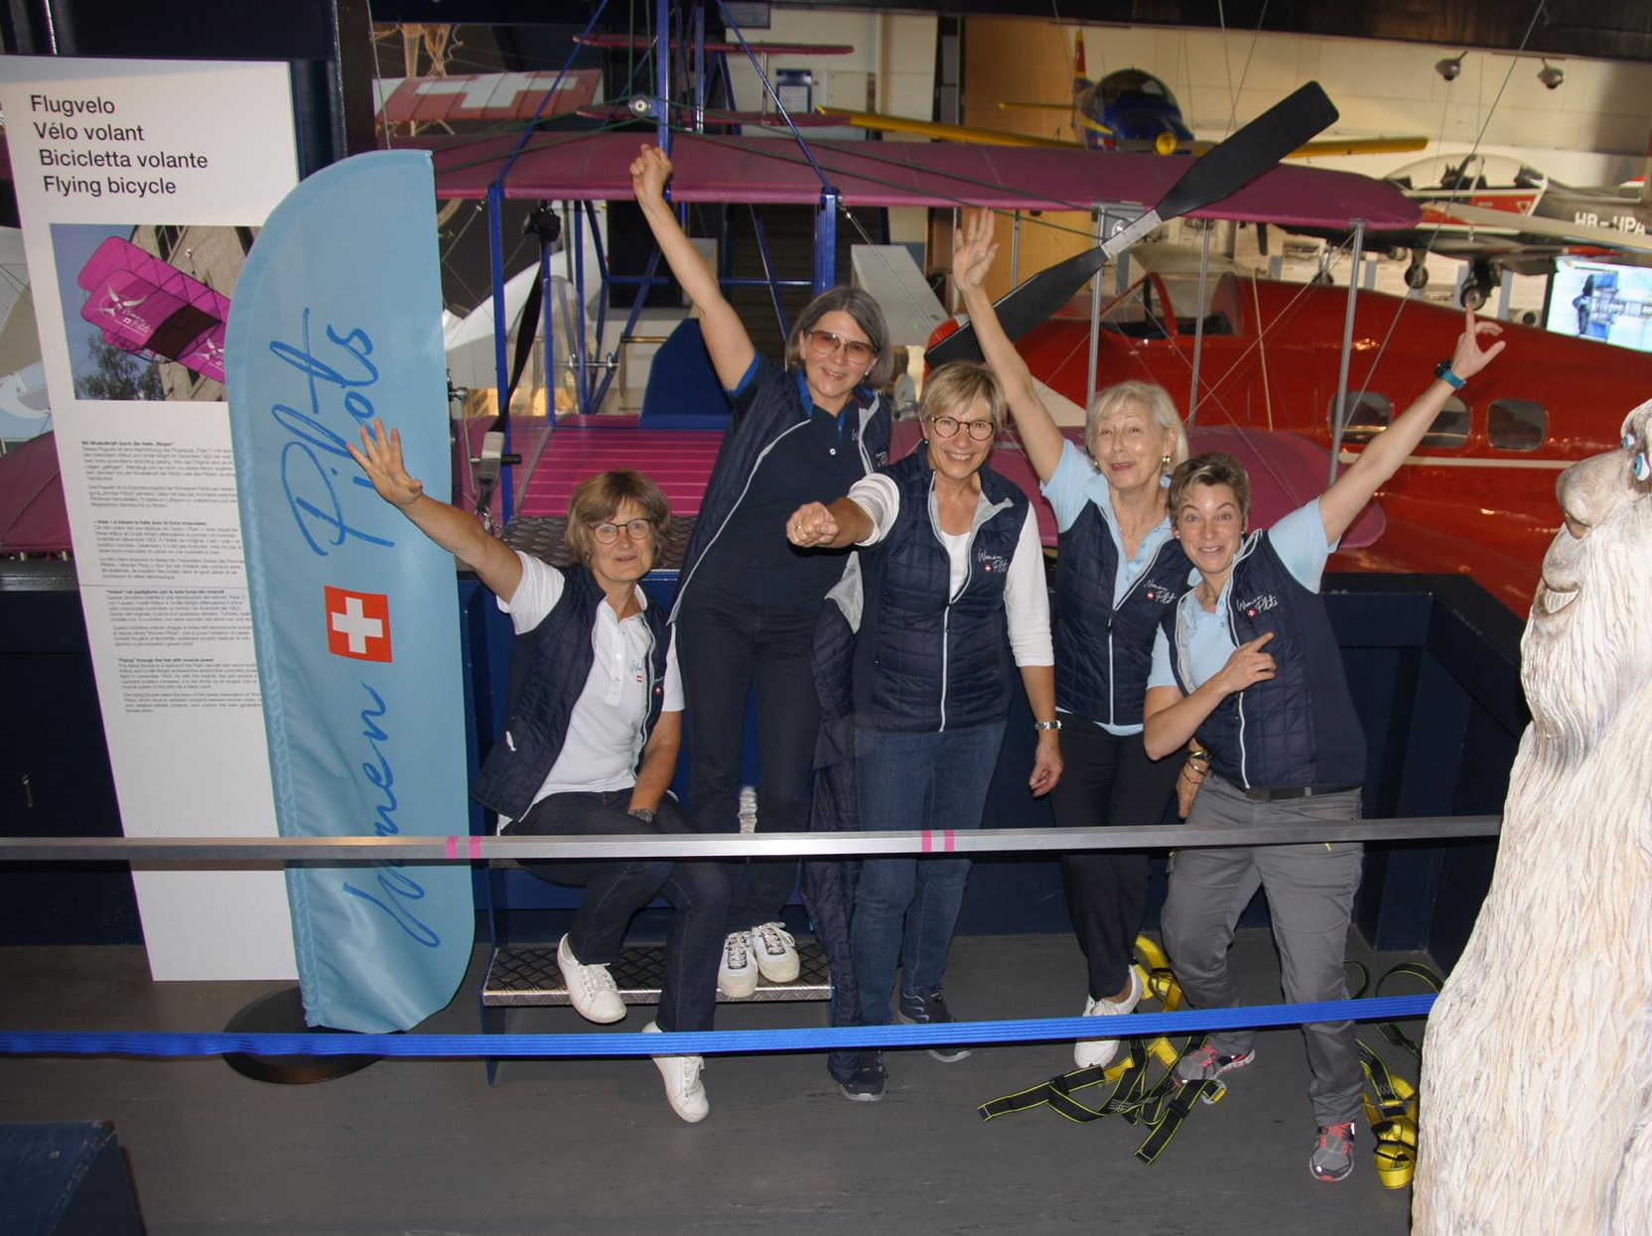
Association Suisse de Femmes Pilotes
The ASFP is founded in 2008 as Les Sternette du Ciel Suisse and since 2010 as ASFP with 86 members.
In 2019 ASFP represented the asso-ciation at the Air and Space Days at the Luzern Swiss Museum of Transportation. The pink flying machine gave girls the feeling of flying.
Short term objectives: exchange flight experiences, knowledge and network.
Air Navigation Race, Safety Training.
Long term objectives: support/funding programmes for female aviation careers. Girls Aviation Day.

Slide 21

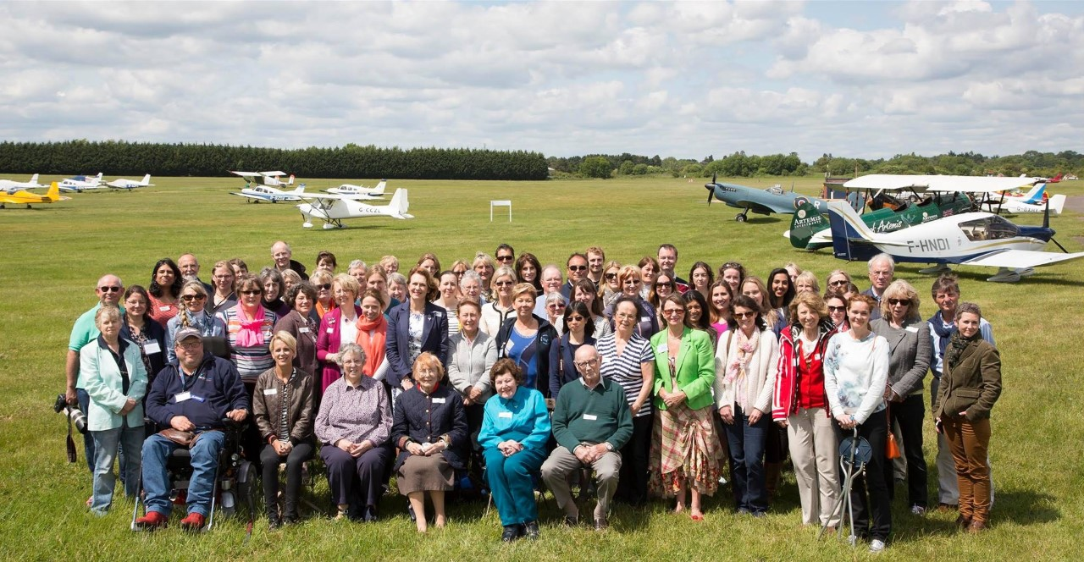
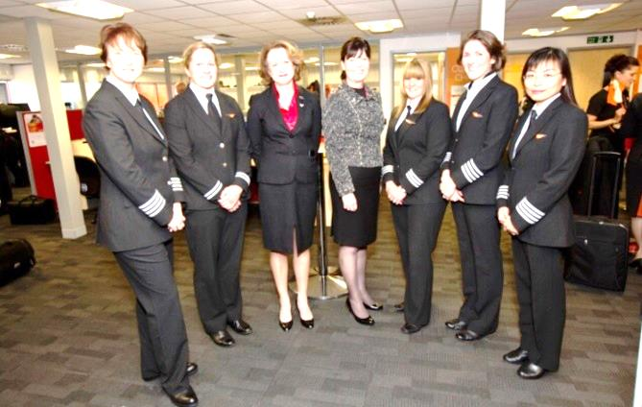
British Women Pilots Association
Diamond Anniversary event at White Waltham Airfield
Two of the past presidents of BWPA (Pauline Vahey and Julie Westhorp –center) together with an Easy Jet flight crew.
The BWPA was founded in 1955 and has 300 members.
Some of the focal points: To promote and advise the training and employment of women in aviation, to show young people the possibility of aviation as a career or recreational activity, to enable members of the Association to meet and exchange knowledge and promote aviation for women in articles and newsitems.
Regular events, money raisers for scholarships, an extensive website with a wealth of information.

Slide 22

Summary of national activities
Fly In’s and meetings on airfields
Competitions in navigation, airrally’s
Trainings in general and safety issues
Promotion of flying for young girls
Presentations at schools, clubs, associations
Participating in exhibitions, airfairs
Publications in magazines, newspapers, books, etc.
Network for women in aviation
Partnerships with other aviation officials
Supporting and sponsoring women in aviation

Slide 23

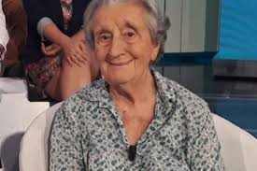
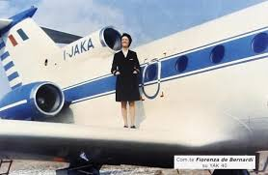
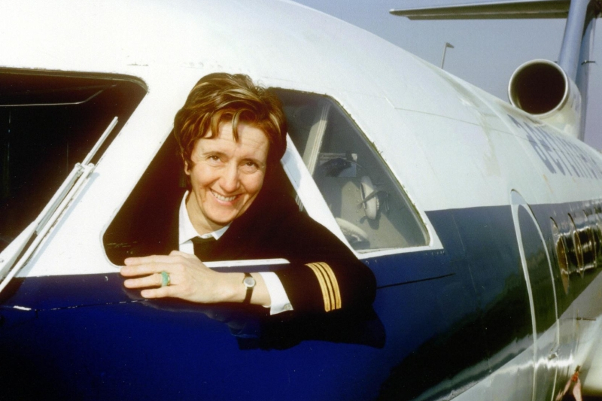
Famous members
Fiorenza di Bernardi, Italy
Fiorenza is the daughter of Mario di Bernardi (famous testpilot)
and the first female commercial (mountain)pilot in Italy. She flew Twin Otter, Yak-40 and DC8. She wrote a book about her life as a pilot. She is honorary member of FEWP and 91 years of age.

Slide 24
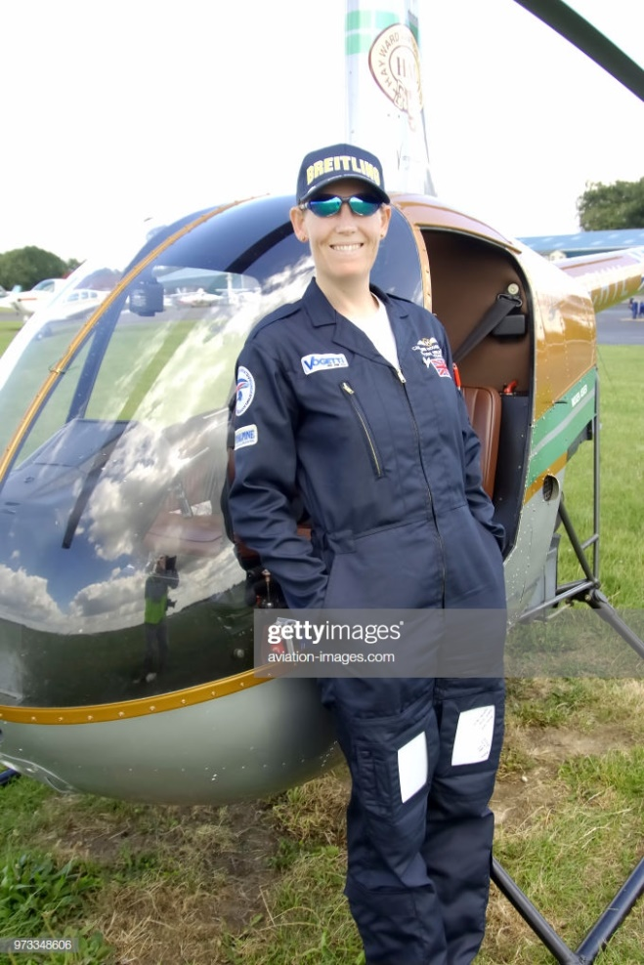
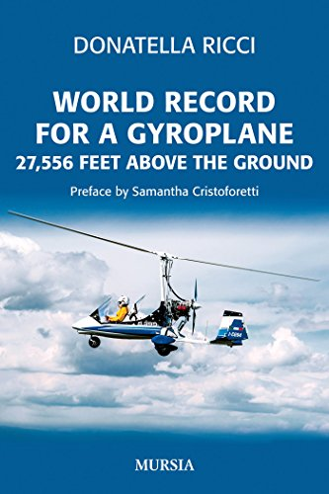
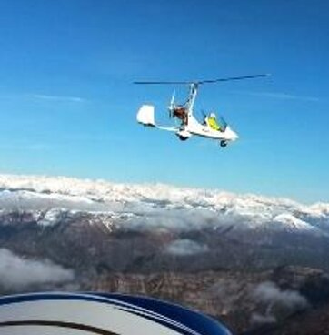
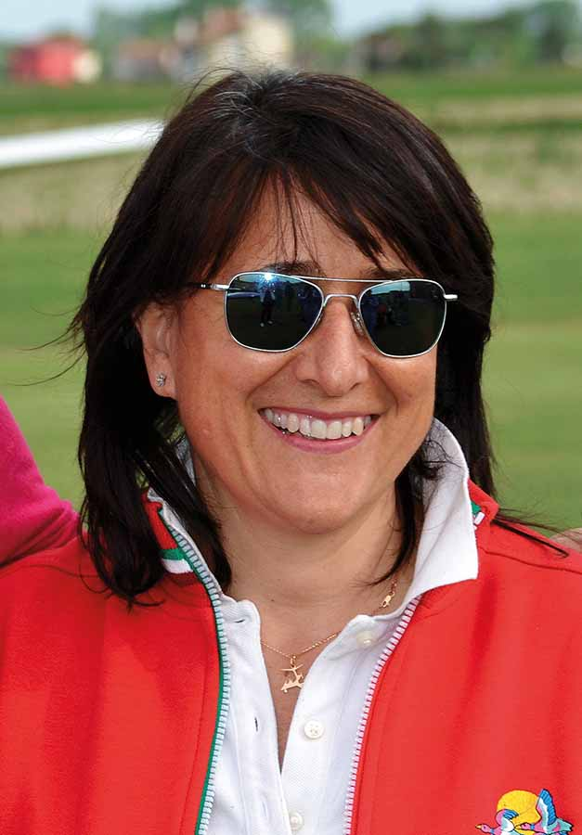
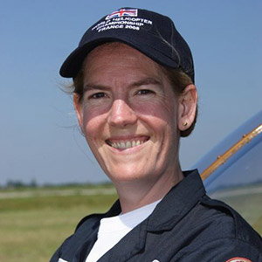
Famous members
Donatella Ricci, Italy and Caroline Gough-Cooper, UK
Donatella is the first Italian female president of the hot air balloon association, candidate for astronaut of ESA, and holds a high altitude record with Gyrocopter.
Caroline is a UK commercial pilot, flies F27, Lockheed Electra, Dash 8 series and won two gold medals on World Championships Helicopter with R22.

Slide 25
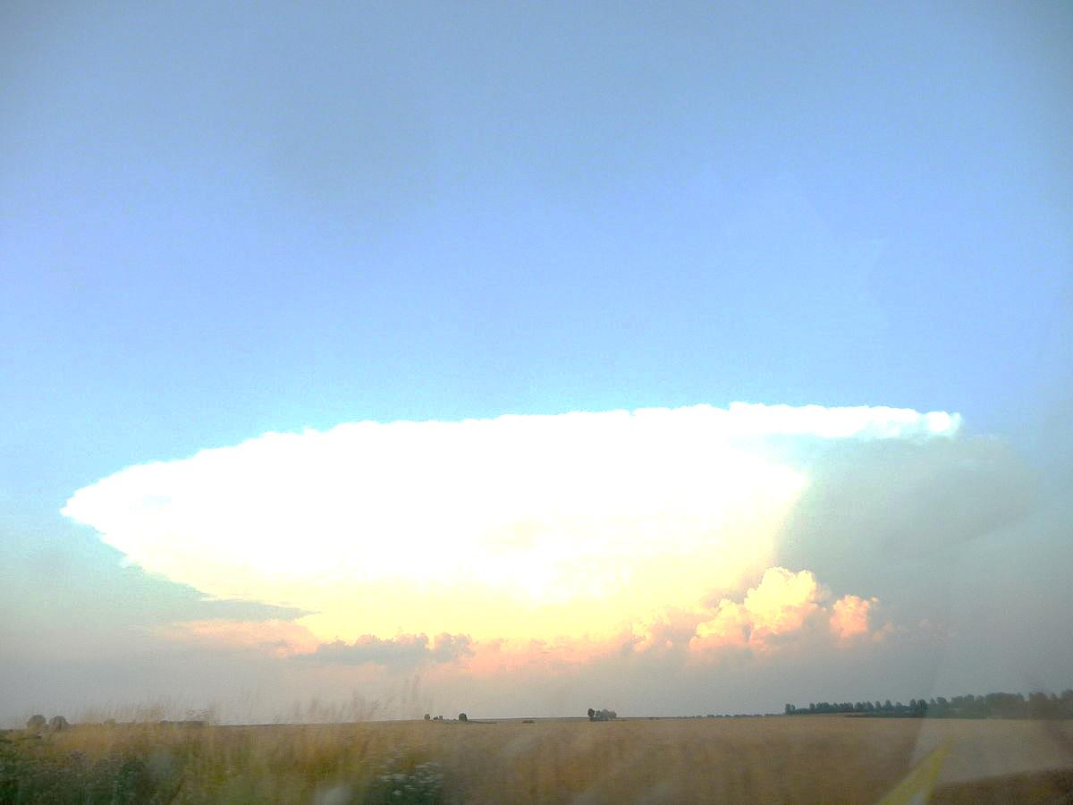
Belgian Women Pilots Association?
Belgian Women in Aviation?
Vereniging van Belgische Vrouwen Piloten?
Droom of werkelijkheid?
Wie gaat er samen
met een paar enthousiaste vrouwen piloten
een Belgische organisatie opzetten?
Informatie: Nathalie Chudiak,
chudiak@hotmail.com
Your own PR message

